Slide 1
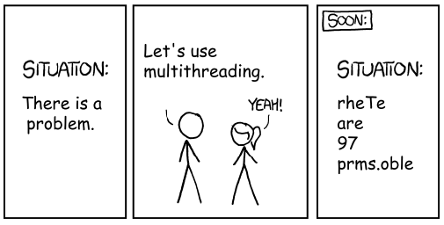
Software Engineering
Threading

Slide 2
What Actually Is Java Code?
What does java MyProgram actually do?
Tells the operating system to start a process
The process runs the JVM (Java Virtual Machine)
Fun fact: the JVM is an API between compiled java code and the actual OS
The JVM calls the public static void main(String[] args) that we know and love on the main thread

Slide 3
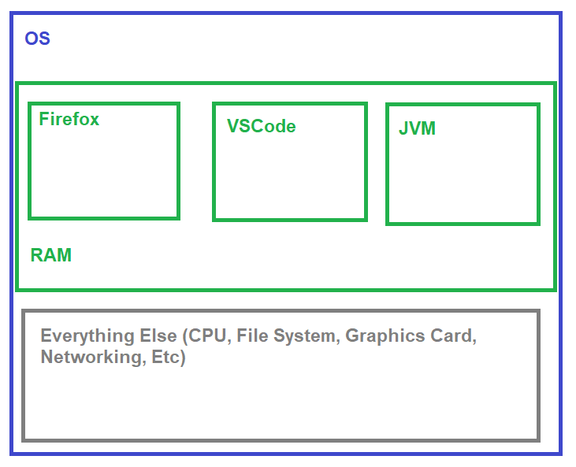
Process vs Thread
A process has an OS-level chunk of memory
No process is allowed to mess with another's memory
All other resources (File System, etc) are shared between processes

Slide 4
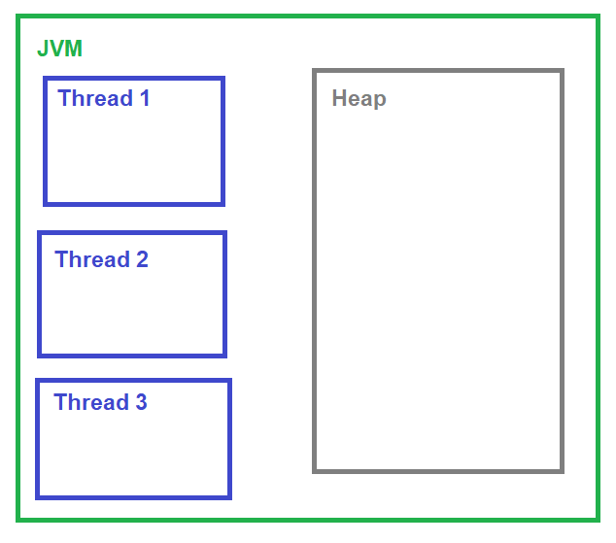
Process vs Thread
A thread is contained within a process
It has its own memory (stack) and shared memory (heap)
It can only use one core of one CPU at a time (linearly follows instructions)

Slide 5
Stack: (Mostly) Primitive Types
Data on the stack is a fixed, known size.
Local variable primitive types: int, boolean, long, etc

Slide 6
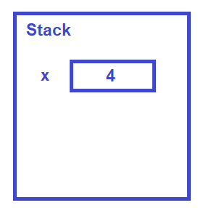
Simple Local Variable: On the Stack
int x = 4;

Slide 7
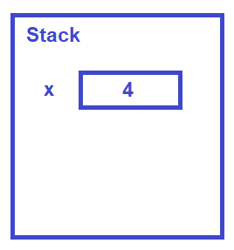
Why is it called the "Stack"?
Variables get pushed onto the stack, then popped when you leave a scope (usually a curly-brace section)
Ex:
int x = 4;
while (x < 5) {
int y = x;
x = y + 1;
}

Slide 8
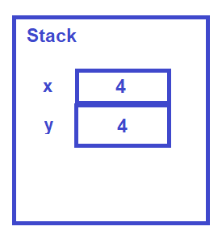
Why is it called the "Stack"?
Here, y is now in scope
Ex:
int x = 4;
while (x < 5) {
int y = x;
x = y + 1;
}

Slide 9
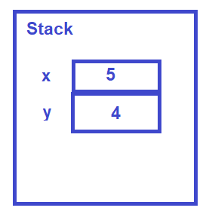
Why is it called the "Stack"?
We're still within the inner braces, so the stack is unchanged (just the values change)
Ex:
int x = 4;
while (x < 5) {
int y = x;
x = y + 1;
}
return x;

Slide 10
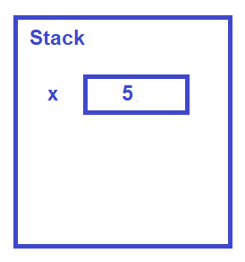
Why is it called the "Stack"?
Now y is out of scope, so it gets popped off the stack. This is why scopes are nested!
Ex:
int x = 4;
while (x < 5) {
int y = x;
x = y + 1;
}
return x;

Slide 11
What Else is On The Stack?
Program Control Metadata:
Instruction Pointer - what line of code to go to next
Return values
Parameters
Stack being tightly controlled ⇒ very difficult to accidentally overwrite this data
When people say Java is a “secure” language, this is what they mean

Slide 12
What's on The Heap?
Almost everything!
All fields within a class
Anything to the right of a new
String literals

Slide 13
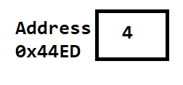
Pointers
Claymation, pointers, and hilarity: https://www.youtube.com/watch?v=vm5MNP7pn5g
Primitive type:
int x = 4;
In Memory:
In Program:
"Hey computer, when I say x, I mean the 4 bytes located at 0x44ED"

Slide 14
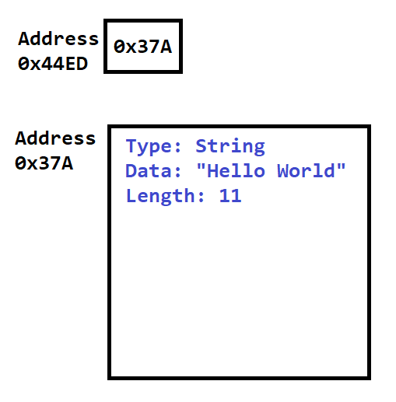
Pointers
In Memory
Object type:
String s = "Hello World";
In Program:
"Hey computer, when I say s, I mean the 8 bytes located at 0x44ED"

Slide 15
Pointers
In Memory
Object type:
String s = "Hello World";
s.length();
In Program:
"Hey computer, when I say ., start with the 8 bytes at the variables address, then 'follow the pointer' and use the data located at the memory address stored in those 8 bytes"

Slide 16
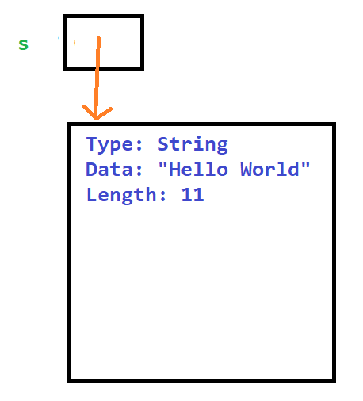
Pointers
Shorthand
Object type:
String s = "Hello World";
The pointer “s” is on the stack, the data pointed to is on the heap

Slide 17
Objects on The Heap
public class FileSystem {
private final File root;
private int numFiles;
public FileSystem() {
root = new File("/home");
numFiles = 1;
}
}
What does
FileSystem fs = new FileSystem();
do?

Slide 18
Objects on The Heap
public class FileSystem {
private final File root;
private int numFiles;
public FileSystem() {
root = new File("/home");
numFiles = 1;
}
}
Step 1: Create a "shell" FileSystem object on the heap
Type: FileSystem
root: 0
numFiles: 0

Slide 19
Objects on The Heap
public class FileSystem {
private final File root;
private int numFiles;
public FileSystem() {
root = new File("/home");
numFiles = 1;
}
}
Step 2: Call the constructor:
root = new File("/home");
Type: FileSystem
root:
numFiles: 0
Type: File
…fields go here…

Slide 20
Objects on The Heap
public class FileSystem {
private final File root;
private int numFiles;
public FileSystem() {
root = new File("/home");
numFiles = 1;
}
}
Step 3: Call the constructor:
numFiles = 1;
Notice that the fields are on the heap, even if they have a primitive type
Type: FileSystem
root:
numFiles: 1
Type: File
…fields go here…

Slide 21
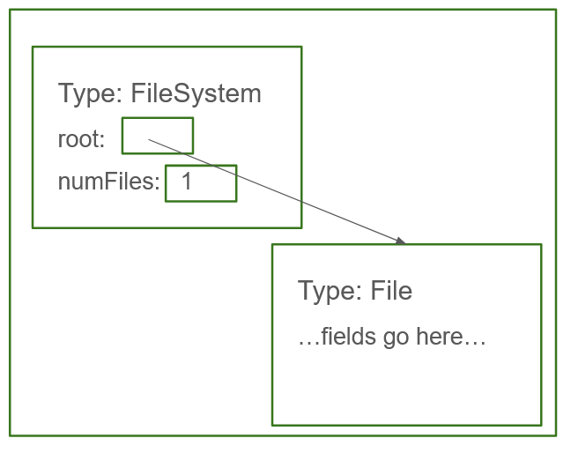
Objects on The Heap
Stack
fs
public class FileSystem {
private final File root;
private int numFiles;
public FileSystem() {
root = new File("/home");
numFiles = 1;
}
}
Step 4: Set up the local variable
FileSystem fs = new FileSystem();
Note that Java is a strongly typed language - each blob o' bytes knows what type it is
Not true in languages like C or Python
Heap

Slide 22

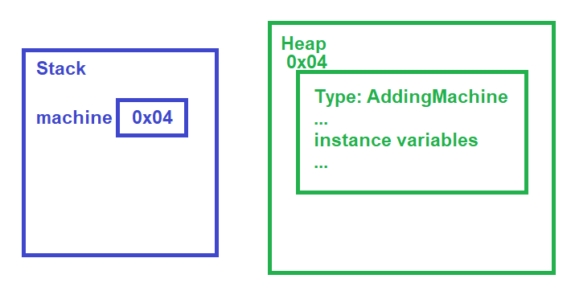
Practical Applications of Deconstruction
AddingMachine machine = new AddingMachine();

Slide 23

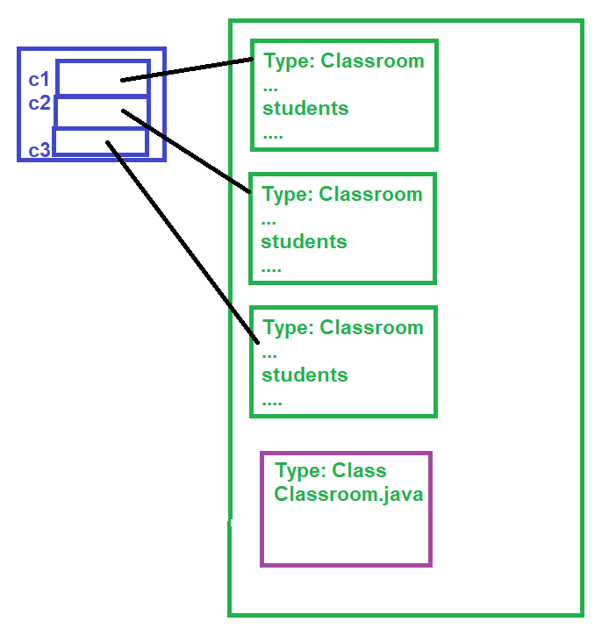
Distinction Between "class" and "instance"

Slide 24
What About Arrays?
Contiguous block on the heap
The array knows its length (big difference in Java)

Slide 25
Exercise: Match the code with the memory layout
Check out the ThreadingExercises repo (link on Brightspace)
Work through MemoryMatching.pdf

Slide 26
Parameters: Pointers vs Pointees
In Java:
All primitive types are passed by value: a copy of the data is made, modifying it doesn’t change the original
All object types are passed by reference: a copy of the pointer is made, but not the data, so modifying the data changes the original
Alt interpretation: all parameters are passed by making a copy of what’s on the stack, but not copying what’s on the the heap

Slide 27
What Does This Print?
public static void main(String[] args) {
int one = 1;
int two = increment(one);
System.out.println(one);
System.out.println(two);
}
/** Adds 1 to the value */
public static int increment(int value) {
value++;
return value;
}

Slide 28
What About This?
public static void main(String[] args) {
IntObject one = new IntObject(1);
IntObject two = increment(one);
System.out.println(one.value);
System.out.println(two.value);
}
/** Adds 1 to the value */
public static IntObject
increment(IntObject intObject) {
intObject.value++;
return new IntObject(intObject.value);
}
public class IntObject {
public int value;
public IntObject(int initialValue) {
value = initialValue;
}
}

Slide 29
Your Turn! (Pointers, Heap, Stack recap)
Look at the exercise1 package in ThreadingExercises
The program is supposed to print out a week's worth of dates
Ex:
Info for the day 9/25/2024 (the next day will be 9/26/2024)
Info for the day 9/26/2024 (the next day will be 9/27/2024)
etc
But it's not quite right - first identify what's wrong with the output
Now, fix the code to print the days as it’s supposed to

Slide 30

Threads
Thread
Heap
Stack

Slide 31





Threads
Player 1
Each thread follows the same rules, but the actual behavior can differ:
Player 1 plays a yellow 9 ⇒ Player 2 plays a 4
or
Player 1 plays a green 3 ⇒ Player 2 plays a 5
Player 2

Slide 32
Threads in Java
Don't ever use low-level threading classes: Thread, wait, notify
multi-threaded code has enough bugs as it is, don't make your life harder
Instead, use the java.util.concurrent library (comes with the jre, much like java Collections)
To create a thread: use a ThreadPool, generally wrapped by an ExecutorService
To tell the thread what it should do, use a Callable<T> (supports lambda syntax)
To check on what the thread did, use a Future<T> and call get()

Slide 33
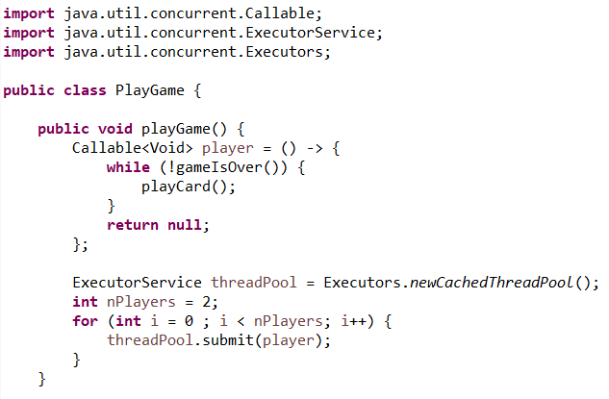
Threads in Java
Use the java.util.concurrent library
Your IDE will figure out these imports for you!

Slide 34
Threads in Java
The Callable determines what each thread will do.
No return value ⇒ use the Void type
null is the only valid value for something of type Void ⇒ always return null for this type

Slide 35
Threads in Java
Use Executors to get an ExecutorService to run the threads
newCachedThreadPool is a good default
Other options:
give all the threads a name
use a fixed size pool
define what should happen if too many things are submitted to the service
many more

Slide 36

Threads in Java
Use submit to actually start a thread
This code is missing something important!
Handling exceptions
Waiting for the threads to finish running

Slide 37
Exceptions & Threads
An exception will halt the thread it happens on, but doesn't cross thread boundaries on its own
Use Future to find out about those exceptions

Slide 38
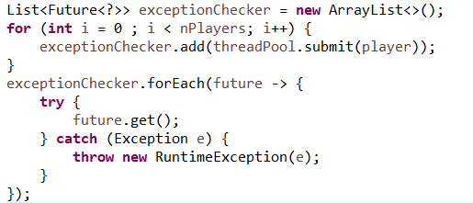
Threads in Java
Use Future to do two things:
Wait for a thread to finish, and return its result
Check for an Exception
.get() is a blocking call - you may not want to call it right away

Slide 39
Your turn!
Look at the exercise2 package in ThreadingExercises
Check that the smoke test runs successfully
Modify the PlayGame code to allow two players to play at once (there are no turns in this game, everyone plays as fast as they can)
Check that the smoke test still runs successfully
Don't worry about any of the logic in AbstractGame for now

Slide 40
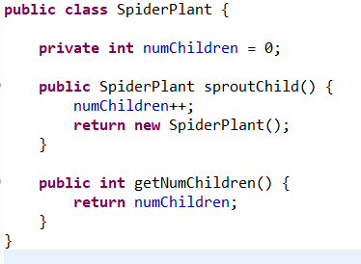
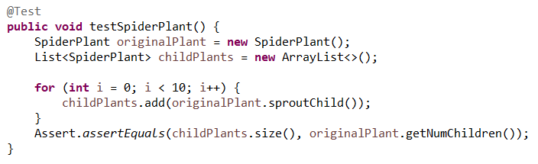
Problems with Threads
This code works just fine with a single thread
But what about with threads?
To the IDE!

Slide 41
Problems with Threads
Heisenbugs: observing multithreaded code in the debugger changes the behavior of the code
When debugging multi-threaded code:
Make it single-threaded
Slowly shrink the section that is multi-threaded until you find the bug
This section of code is called a critical section, and must be protected from concurrent execution

Slide 42

Locking
A lock is a shared (on the heap!) object that only allows one thread to execute a piece of code at once
To execute the code, the thread acquires the lock, holds the lock while running, and then releases the lock
Lock Attributes:
re-entrant: If a thread already holds the lock, it can re-acquire the lock
Important to avoid deadlock
fair: threads receive the lock in roughly the order they request it

Slide 43

Synchronized
synchronized: Java keyword to protect code that must be single-threaded
Not fair
Re-entrant
By default, lock is per object, but can specify any object

Slide 44
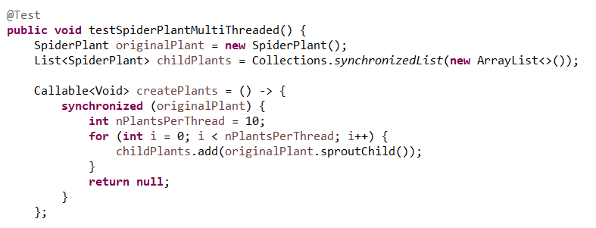
Synchronized
synchronized: Java keyword to protect code that must be single-threaded
Heuristic: always synchronize on the shared object

Slide 45
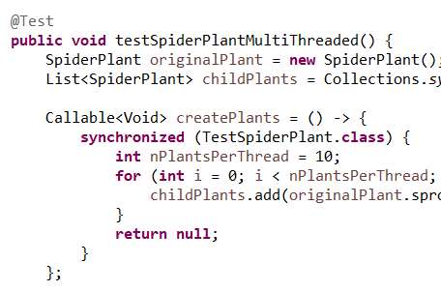
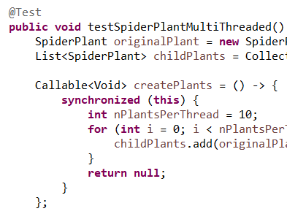
When In Doubt, Synchronize Broadly
Then binary-search to where the bug is

Slide 46
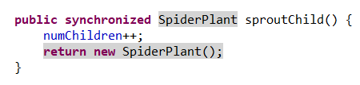
Synchronized on Methods
On a method, synchronized implicitly uses (this) as the lock object
This makes the method atomic (ie, single-threaded - it's run as one atomic, indivisible, block)

Slide 47
Race Condition
Threads are racing to get to the code, and they trip over each other
numChildren = numChildren + 1:
Thread:
Copy the value of numChildren into a register
Increment that value by 1
Write the result back to numChildren

Slide 48
Race Condition
numChildren = numChildren + 1: Assume numChildren = 4 to start
Thread:
Copy the value of numChildren into a register (register = 4)
Increment that value by 1 (register = 5)
Write the result back to numChildren (numChildren = 5)
Thread:
Copy the value of numChildren into a register (register = 4)
Increment that value by 1 (register = 5)
Write the result back to numChildren (numChildren = 5)

Slide 49
Your Turn!
Look at the exercise3 package in ThreadingExercises
Add synchronized blocks to fix the failing unit test (note: the test may not fail right away, you may have to run it a few times)
What’s another way to fix this that doesn’t involve synchronized?

Slide 50

Semaphore
What if you want threads to take turns in a more organized fashion?
A semaphore allows some number of threads to run at once, but no more than that
Ex: a section of train track with only two tracks should only permit two trains at a time to enter
Supports fair rotation through waiting threads:
Semaphore s = new Semaphore(2, true);

Slide 51
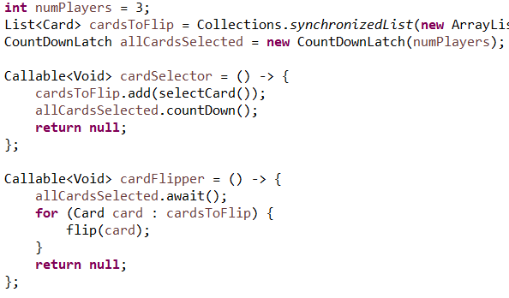
CountDownLatch
Used to wait for several threads to all complete a task
Similar to using get on a Future
Ex: Everyone picks a card to play, and places it face down in front of them. Once everyone has picked a card, then everyone flips theirs over.

Slide 52
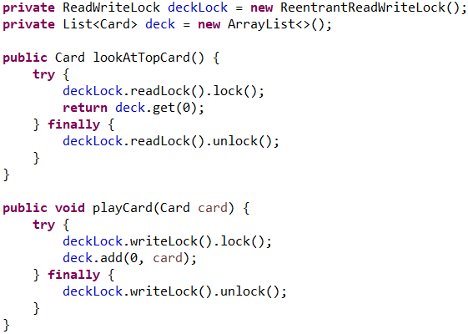
Read/Write Locks
Two related locks - one allows for many threads to access something, one locks all threads out.
Ex: Reading vs writing a file
Write lock - identify under what circumstances code needs to be single threaded (generally, changing a value)
Read lock - add this around any code that can't run while the write lock is held
Note the try/finally - necessary whenever you're handling locking/unlocking

Slide 53
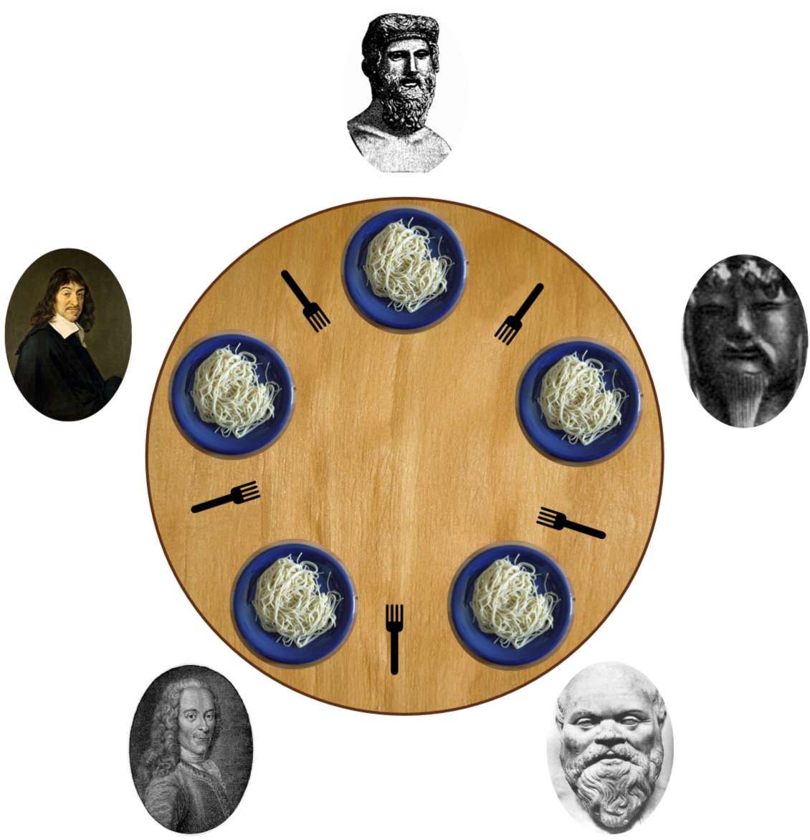
Deadlock
Two (or more) threads are waiting on resources the other thread holds
No thread can make further progress, and the program grinds to a halt

Slide 54
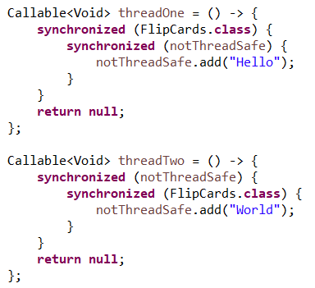
Deadlock
First, threadOne acquires the FlipCards.class lock
Next, threadTwo acquires the notThreadSafe lock
Now they're stuck - neither thread can execute its next line of code until the other thread exits its synchronized block
⇒ For multi-threading tests, it's a good idea to include a timeout

Slide 55
Deadlock
ReadWrite Locks are especially prone to this, even when they're mostly re-entrant:
Acquire read lock, then read lock - re-entrant; if this thread already has a read lock, no one else can hold a write lock, so it's always safe to grant the read lock
Acquire write lock, then write lock - re-entrant; if this thread already has a write lock, no one else can hold a read or write lock, so it's always safe to grant the write lock
Acquire write lock then read lock - that's fine, we know no other thread can be holding either the read or write lock
Acquire the read lock then the write lock - NOPE

Slide 56
Deadlock
ReadWrite Locks are especially prone to this:
Thread 1: "I would like to acquire the read lock"
ReadWrite Lock: "Sure, here you go!"
Thread 2: "I would like to acquire the read lock"
ReadWrite Lock: "Sure, here you go!"
Thread 1: "I would like to acquire the write lock"
ReadWrite Lock: "Sure thing, as soon as everyone releases the read lock"
Thread 2: "I would like to acquire the write lock"
ReadWrite Lock: "Sure thing, as soon as everyone releases the read lock"
Thread 2: …
Thread 1: …
ReadWrite Lock: …

Slide 57
Your Turn!
Look at the exercise4 package in ThreadingExercises
Fix the warning/TODO around the List
Update the code so that the output list is sorted in descending order (you can check by running the test)
Note that there is also a race condition that causes some numbers to be skipped entirely! Fixing the ordering will fix this too
It's ok if the factorials print to the console out-of-order
Hint: You'll need multiple locks

Slide 58

Producer/Consumer Pattern
Design Patterns: Not just for single-threaded code!
Problem:
How to parallelize code that runs through a pipeline?
Solution: Use locks to handle passing partially completed jobs from one task to another
For ex: allows IO intensive computation at the same time as a CPU or network computation

Slide 59
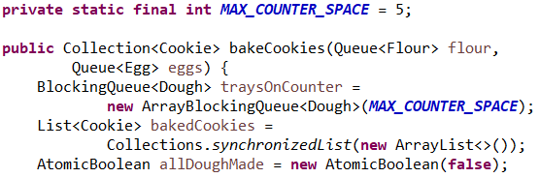
Producer/Consumer Pattern
To set up the pipeline:
1: Set up how each stage will hand off to the next
Often, an ArrayBlockingQueue
Configure the queue with how
many items can pile up while
waiting to be processed

Slide 60
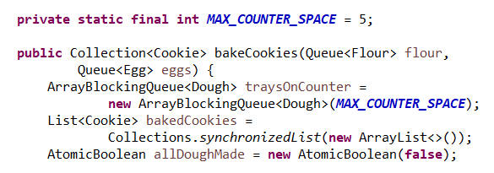
Producer/Consumer Pattern
To set up the pipeline:
1: Set up how each stage will hand off to the next
Make sure to signal when no more work is coming

Slide 61
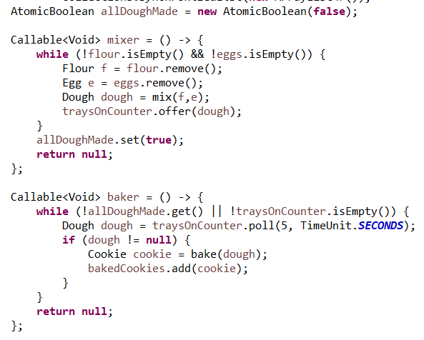
Producer/Consumer Pattern
To set up the pipeline:
2: Set up each stage of the pipeline
classic Callable we saw last week
each Callable handles one stage

Slide 62
Producer/Consumer Pattern
To set up the pipeline:
3: Coordinate the handoff between stages
offer - similar to put/add/enqueue, except that this will block until space is available
Why?
Memory pressure
More evenly distribute CPU/disk/etc among stages

Slide 63
Producer/Consumer Pattern
To set up the pipeline:
3: Coordinate the handoff between stages
poll - similar to get/remove/dequeue, except that this will block until an element is available
Tricky part: what if no more dough is going to be made?

Slide 64
Producer/Consumer Pattern
To set up the pipeline:
3: Coordinate the handoff between stages
Always include a timeout with poll
previous stage fails
previous stage may not immediately know when it's done (filter step, waiting on a previous stage)

Slide 65
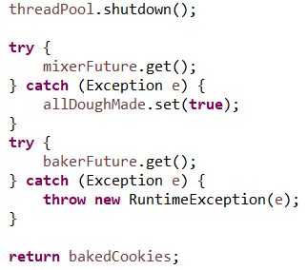
Producer/Consumer Pattern
Wait for the pipeline to finish
Future.get() will block until the task completes
If a stage fails, make sure to still inform subsequent stages

Slide 66
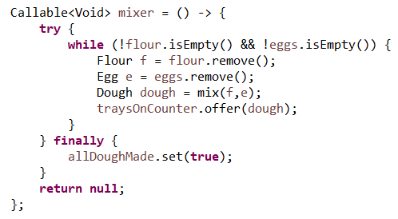
Producer/Consumer Pattern
Slightly better error handling:
try must be combined with at least one of:
try-with-resources, ex: try (FileWriter f = new FileWriter("out.txt")) {}
catch which includes exception handling
finally which runs some very short code whether an exception is thrown or not

Slide 67
Producer/Consumer Pattern
Risk with finally/catch blocks:
Throwing an exception within the finally block
obscures the original error
may not handle all cleanup properly
Often untested in the failure case
NPEs are common

Slide 68
Your Turn!
Look at the exercise5 package in ThreadingExercises
Change the ExerciseSolver to a parallel pipeline with 2 stages; assume you can queue up 10 exercises to be solved at a time
Verify that both tests in TestExerciseSolver pass; initially, only one should pass, but they take a few seconds to run

Slide 69

Interrupts
What if you unexpectedly want to stop a Callable early?
The interrupt flag on a thread tracks whether another thread has asked this one to stop
Caution: generally checking whether a thread is interrupted also clears this flag:
Thread.interrupted()
= 'have I been interrupted since the last time I asked?'

Slide 70
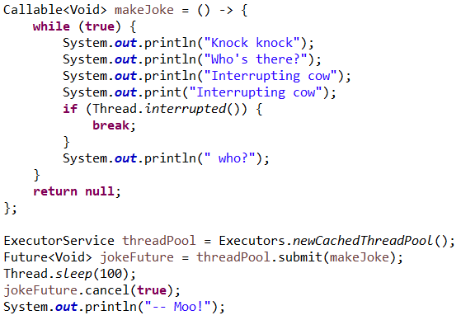
Interrupts
To tell a thread to stop early, use
Future.cancel(true)
keep the Callable from ever running if it hasn't started yet
set the interrupt flag if the Callable has started
Note: any calls to Future.get will immediately throw a CancellationException
to wait for the thread to actually cancel, you need a lock/shared state

Slide 71
Interrupts
What things check the interrupt flag?
Most blocking calls
Anything that throws InterruptedException
One option if you don't want to re-throw an InterruptedException:
catch (InterruptedException) {
Thread.interrupt();
}

Slide 72
Let's Review: Threading
Stack vs Heap - what data goes where
Translating code to a sketch of what memory looks like
How are pointers configured
Pass by Reference vs Pass by Value for parameters
Threading Libraries: What are 3 major classes that you would use for handling threads in java?
What is: a deadlock, a critical section of code, and a race condition?
What does the synchronized keyword do, and how do you use it?
What are 3 useful classes for handling locking?

